Slide 1
java this keyword
Instructor :Prashant Mishra
BIAS Bhimtal

Slide 2
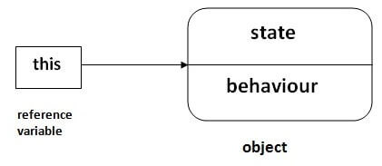
this keyword in java
There can be a lot of usage of java this keyword. In java, this is a reference variable that refers to the current object.
Here is given the 6 usage of java this keyword.
this can be used to refer current class instance variable.
this can be used to invoke current class method (implicitly)
this() can be used to invoke current class constructor.
this can be passed as an argument in the method call.
this can be passed as argument in the constructor call.
this can be used to return the current class instance from the method.

Slide 3
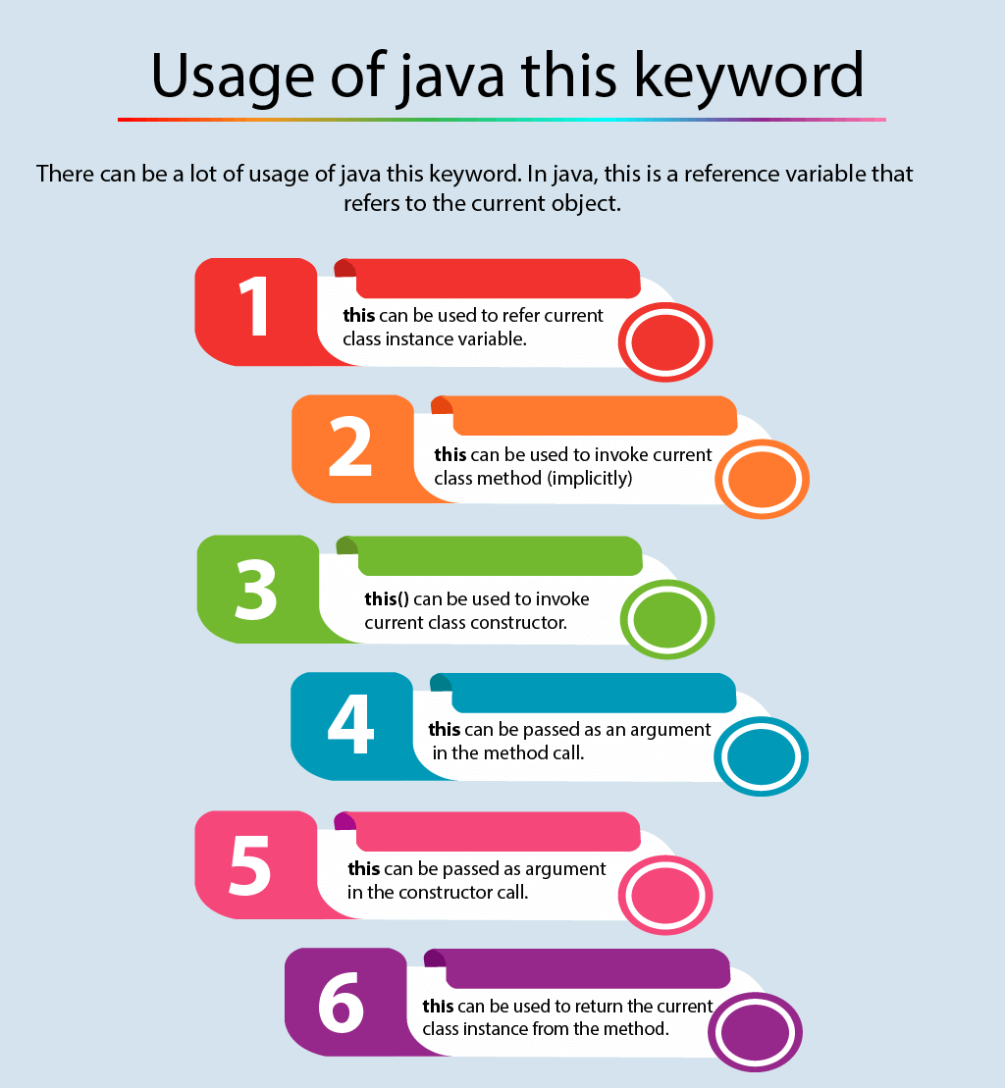

Slide 4
1) this: to refer current class instance variable
The this keyword can be used to refer current class instance variable. If there is ambiguity between the instance variables and parameters, this keyword resolves the problem of ambiguity.

Slide 5
Understanding the problem without this keyword
Let's understand the problem if we don't use this keyword by the example given below:
class Student{
int rollno;
String name;
float fee;
Student(int rollno,String name,float fee){
rollno=rollno;
name=name;
fee=fee;
}
void display(){System.out.println(rollno+" "+name+" "+fee);}
}
class TestThis1{
public static void main(String args[]){
Student s1=new Student(111,"ankit",5000f);
Student s2=new Student(112,"sumit",6000f);
s1.display();
s2.display();
}}
In the above example, parameters (formal arguments) and instance variables are same. So, we are using this keyword to distinguish local variable and instance variable.
Output:
0 null 0.0
0 null 0.0

Slide 6
Solution of the above problem by this keyword
class Student{
int rollno;
String name;
float fee;
Student(int rollno,String name,float fee){
this.rollno=rollno;
this.name=name;
this.fee=fee;
}
void display(){System.out.println(rollno+" "+name+" "+fee);}
}
class TestThis2{
public static void main(String args[]){
Student s1=new Student(111,"ankit",5000f);
Student s2=new Student(112,"sumit",6000f);
s1.display();
s2.display();
}}
Output:
111 ankit 5000
112 sumit 6000
If local variables(formal arguments)
and instance variables
are different, there is no need
to use this keyword

Slide 7
Program where this keyword is not required
class Student{
int rollno;
String name;
float fee;
Student(int r,String n,float f){
rollno=r;
name=n;
fee=f;
}
void display(){System.out.println(rollno+" "+name+" "+fee);}
}
class TestThis3{
public static void main(String args[]){
Student s1=new Student(111,"ankit",5000f);
Student s2=new Student(112,"sumit",6000f);
s1.display();
s2.display();
}}
Output:
111 ankit 5000
112 sumit 6000
It is better approach to use meaningful names for variables.
So we use same name for instance variables and parameters in real time,
and always use this keyword.

Slide 8
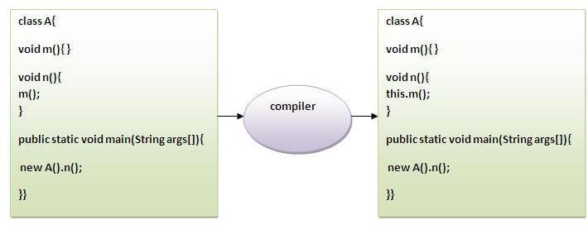
2) this: to invoke current class method
You may invoke the method of the current class by using the this keyword. If you don't use the this keyword, compiler automatically adds this keyword while invoking the method. Let's see the example

Slide 9
class A{
void m(){System.out.println("hello m");}
void n(){
System.out.println("hello n");
//m();//same as this.m()
this.m();
}
}
class TestThis4{
public static void main(String args[]){
A a=new A();
a.n();
}}
Output:
hello n
hello m

Slide 10
3) this() : to invoke current class constructor
The this() constructor call can be used to invoke the current class constructor. It is used to reuse the constructor. In other words, it is used for constructor chaining.
Calling default constructor from parameterized constructor:
class A{
A(){System.out.println("hello a");}
A(int x){
this();
System.out.println(x);
}
}
class TestThis5{
public static void main(String args[]){
A a=new A(10);
}}
Output:
hello a
10

Slide 11
Calling parameterized constructor from default constructor:
class A{
A(){
this(5);
System.out.println("hello a");
}
A(int x){
System.out.println(x);
}
}
class TestThis6{
public static void main(String args[]){
A a=new A();
}}
Output:
5
hello a

Slide 12
Real usage of this() constructor call
The this() constructor call should be used to reuse the constructor from the constructor. It maintains the chain between the constructors i.e. it is used for constructor chaining. Let's see the example given below that displays the actual use of this keyword.

Slide 13
class Student{
int rollno;
String name,course;
float fee;
Student(int rollno,String name,String course){
this.rollno=rollno;
this.name=name;
this.course=course;
}
Student(int rollno,String name,String course,float fee){
this(rollno,name,course);//reusing constructor
this.fee=fee;
}
void display(){System.out.println(rollno+" "+name+" "+course+" "+fee);}
}
class TestThis7{
public static void main(String args[]){
Student s1=new Student(111,"ankit","java");
Student s2=new Student(112,"sumit","java",6000f);
s1.display();
s2.display();
}}
Output:
111 ankit java null
112 sumit java 6000

Slide 14
Program where this keyword is not required
class Student{
int rollno;
String name;
float fee;
Student(int r,String n,float f){
rollno=r;
name=n;
fee=f;
}
void display(){System.out.println(rollno+" "+name+" "+fee);}
}
class TestThis3{
public static void main(String args[]){
Student s1=new Student(111,"ankit",5000f);
Student s2=new Student(112,"sumit",6000f);
s1.display();
s2.display();
}}
It is better approach to use meaningful names for variables. So we use same name for instance variables and parameters in real time, and always use this keyword.
Output:
111 ankit 5000 112 sumit 6000

Slide 15
Rule: Call to this() must be the first statement in constructor.
class Student{
int rollno;
String name,course;
float fee;
Student(int rollno,String name,String course){
this.rollno=rollno;
this.name=name;
this.course=course;
}
Student(int rollno,String name,String course,float fee){
this.fee=fee;
this(rollno,name,course);//C.T.Error
}
void display(){System.out.println(rollno+" "+name+" "+course+" "+fee);}
}
class TestThis8{
public static void main(String args[]){
Student s1=new Student(111,"ankit","java");
Student s2=new Student(112,"sumit","java",6000f);
s1.display();
s2.display();
}}
Compile Time Error: Call to this must be first statement in constructor

